Slide 1
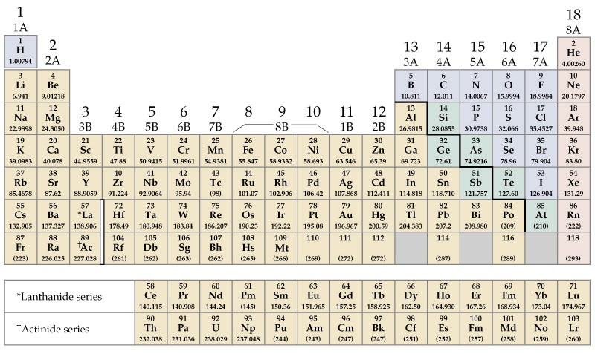
Review: The Periodic table
1
2
3
4
5
6
7
General Chemistry: Chapter 2
Copyright © 2011 Pearson Canada Inc.

Slide 2
The Periodic table
Elements are organized according to observable properties
Elements are listed according to increased atomic mass (& atomic number)
Horizontal rows periods
Similar elements line up in columns ( groups)
Symbol (with the Z and A values) are given in each square
First period: 2 elements, 2nd and 3rd periods have 8 elements
4th and 5th periods have 18 elements
6th and 7th periods have 32 elements
Obvious properties:
  metals and non-metals (metalloids)
  some elements are gases, most are solids (2 are liquid)
  Main group elements (groups 1, 2, 13, 14, 15, 16, 17)
Notes:
Chemistry 140 Fall 2002

Slide 3
The Periodic table
Alkali Metals
Noble Gases
Alkaline Earths
Main Group
Halogens
1
2
3
4
5
6
7
Transition Metals
Main Group
Lanthanides and Actinides
General Chemistry: Chapter 2
Copyright © 2011 Pearson Canada Inc.

Slide 4
The Periodic table
Main Group
1
2
3
4
5
6
7
Main Group
General Chemistry: Chapter 2
Copyright © 2011 Pearson Canada Inc.

Slide 5
The Periodic table
Elements are organized according to observable properties
Elements are listed according to increased atomic mass (& atomic number)
Horizontal rows periods
Similar elements line up in columns ( groups)
Symbol (with the Z and A values) are given in each square
First period: 2 elements, 2nd and 3rd periods have 8 elements
4th and 5th periods have 18 elements
6th and 7th periods have 32 elements
Obvious properties:
  metals and non-metals (metalloids)
  some elements are gases, most are solids (2 are liquid)
  Main group elements (groups 1, 2, 13, 14, 15, 16, 17)
  Main group elements tend to form ions with charge that is related to the group number: groups 1 and 2 form +1 and +2 ions, respectively
  groups 15, 16, 17 form negative ions (-3, -2, -1, resp.)
  Ions have the same number of electrons as the near by “noble gas element”

Slide 6
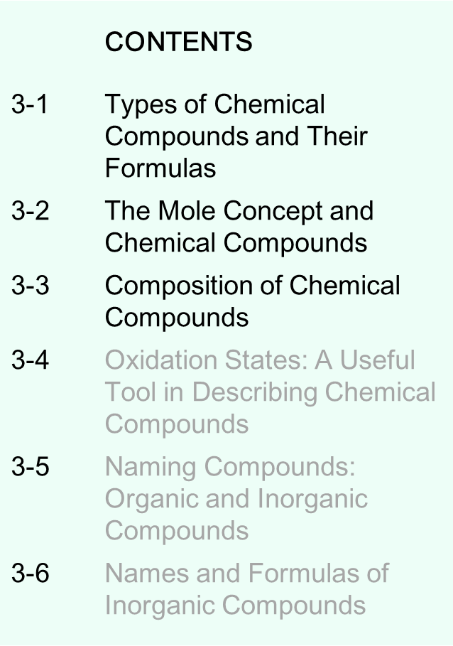

Chapter 3
Chemical Compounds
Slide <number> of 32
General Chemistry: Chapter 3
Copyright © 2011 Pearson Canada Inc.
Notes:
Chemistry 140 Fall 2002
Scanning electron microscope image of sodium chloride crystals.
Chemical compounds, their formulas, and their names are topics discussed in this chapter.

Slide 7
Chemical Compounds
Substances that are formed by only one type of atom: elements
Substances that are formed by more than one type of atom: compounds
Atoms are held together by “bonding”
Covalent bonding → sharing electrons → Molecular Compounds
Ionic bonding → transfer of electrons → Ionic Compounds
Slide <number> of 32
General Chemistry: Chapter 3
Copyright © 2011 Pearson Canada Inc.
Notes:
A molecular compound is made up of discrete units called molecules, which
typically consist of a small number of nonmetal atoms held together by covalent
bonds. Molecular compounds are represented by chemical formulas,
symbolic representations that, at minimum, indicate
• the elements present
• the relative number of atoms of each element
Chemistry 140 Fall 2002

Slide 8
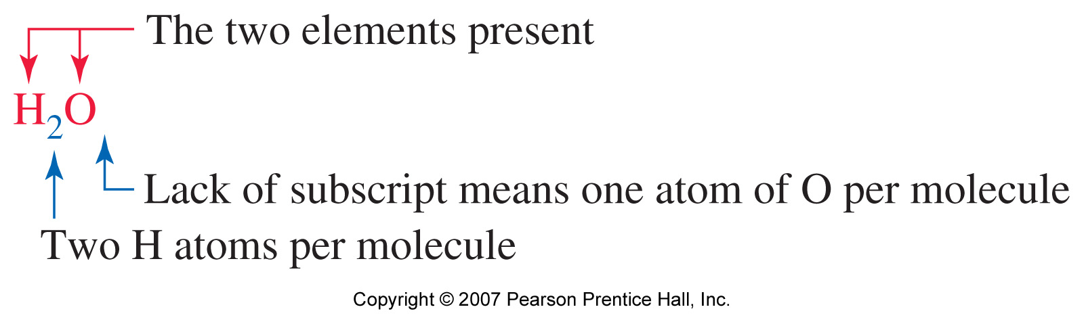
Types of Chemical Compounds and Their Formulas
Molecular Compounds
Form molecules
Represented by chemical formulas
CCl₄
Slide <number> of 32
General Chemistry: Chapter 3
Copyright © 2011 Pearson Canada Inc.
Notes:
A molecular compound is made up of discrete units called molecules, which
typically consist of a small number of nonmetal atoms held together by covalent
bonds. Molecular compounds are represented by chemical formulas,
symbolic representations that, at minimum, indicate
• the elements present
• the relative number of atoms of each element
Chemistry 140 Fall 2002

Slide 9
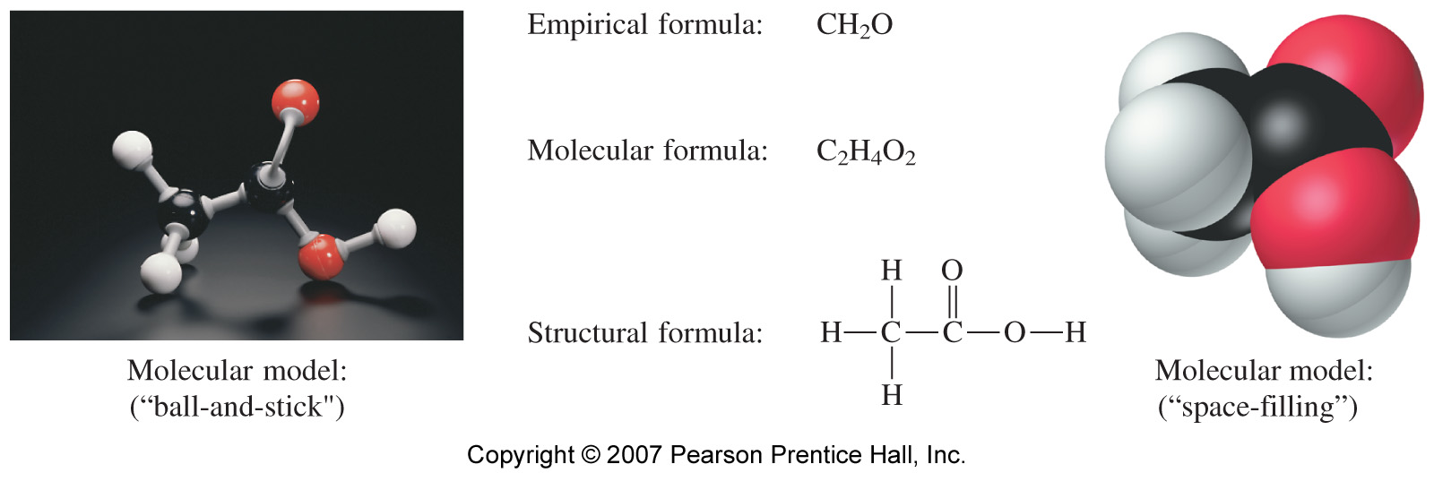
Molecular compounds
Acetic Acid
Simplest.
What elements & in what ratio
Total number of atoms present
How they are bonded to each other
Slide <number> of 32
General Chemistry: Chapter 3
Copyright © 2011 Pearson Canada Inc.
Notes:
Chemistry 140 Fall 2002
Chemical formula – relative numbers of atoms of each element present
Empirical formula – the simplest whole number formula
Structural formula – the order and type of attachements
– shows multiple bonds
- may show lone pairs
- hard to show 3-d
In the molecular model, the black spheres are carbon, the red are oxygen, and the
white are hydrogen. To show that one H atom in the molecule is fundamentally
different from the other three, the formula of acetic acid is often written as HC₂H₃O₂ or (see Section 5-3). To show that this H atom is bonded to an O atom, the formulas CH₃CO₂H and CH₃COOH are also used. For a few chemical compounds, you may find
different versions of chemical formulas in different sources.

Slide 10
Molecular compounds
Acetic Acid
Slide <number> of 32
General Chemistry: Chapter 3
Copyright © 2011 Pearson Canada Inc.
Notes:
Chemistry 140 Fall 2002
Chemical formula – relative numbers of atoms of each element present
Empirical formula – the simplest whole number formula
Structural formula – the order and type of attachements
– shows multiple bonds
- may show lone pairs
- hard to show 3-d
In the molecular model, the black spheres are carbon, the red are oxygen, and the
white are hydrogen. To show that one H atom in the molecule is fundamentally
different from the other three, the formula of acetic acid is often written as HC₂H₃O₂ or (see Section 5-3). To show that this H atom is bonded to an O atom, the formulas CH₃CO₂H and CH₃COOH are also used. For a few chemical compounds, you may find
different versions of chemical formulas in different sources.

Slide 11
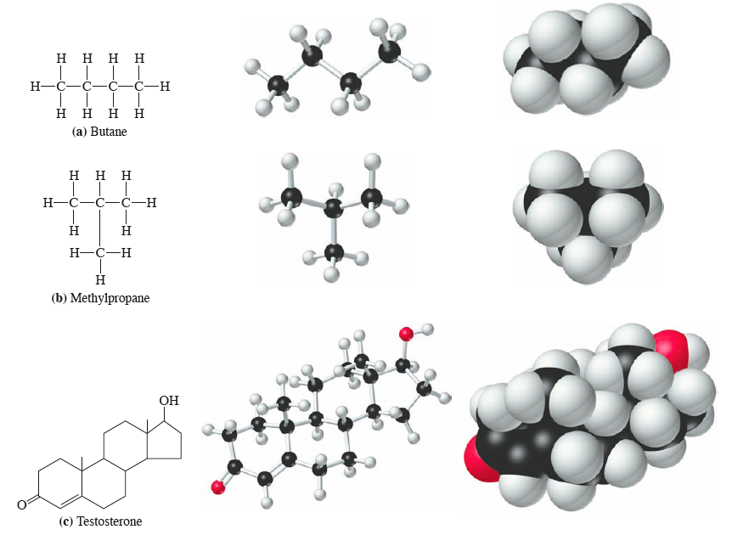
Visualizations of (a) butane, (b) methylpropane, and (c) testosterone
Figure 3-2
Slide <number> of 32
General Chemistry: Chapter 3
Copyright © 2011 Pearson Canada Inc.

Slide 12
Ionic Compounds
Atoms of almost all elements can gain or lose electrons to form charged species called ions.
Compounds composed of ions are known as ionic compounds.
Metals tend to lose electrons to form positively charged ions called cations.
Non-metals tend to gain electrons to form negatively charged ions called anions.
Slide <number> of 32
General Chemistry: Chapter 3
Copyright © 2011 Pearson Canada Inc.
Notes:
Chemistry 140 Fall 2002
Positive and negaive ions joined together by electrostatic forces
Metals tend to lose electrons to form cations
Non-metals tend to gain electrons to form anions
Ionic solids formulae are reported as the formula unit – inappropriate to call it a molecular formula

Slide 13
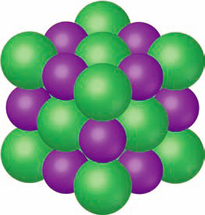
Portion of an ionic crystal and a formula unit of NaCl
An extended array of Na⁺ and Cl⁻ ions
The simplest formula unit is NaCl
Types of ions
Cl¯
Na⁺, Cl⁻ are monatomic
NO₃⁻ is a polyatomic ion
Formula unit
Na⁺
FIGURE 3-4
Slide <number> of 32
General Chemistry: Chapter 3
Copyright © 2011 Pearson Canada Inc.
Notes:
Chemistry 140 Fall 2002
Na loses one electron to form the sodium ion
Cl gains one electron to form the chloride ion
Centers of ions are shown in the ball and stick model for clarity
Space filling model shows how the ions are actually in contact with one another.
We will discuss face centered cubic and other types of packing in chapter 13

Slide 14
The Mole Concept and Chemical Compounds
Mole: Amount of a particle that contains the same number of those particles as there are atoms in 12 g of ¹²C (Avogadro’s number N_{A})
We defined 12 g of ¹²C ≡ 1 mole of ¹²C
We measured the number of atoms/mol to be 6.022 x 10²³ = N_{A}
Particle’s mass expressed in grams is a mole
Example: 1 mole of Pb = g
Mole of a compound: Mass of a compound that contains N_{A} of molecules of that compound
Example: H₂O

Slide 15
The Mole Concept and Chemical Compounds
KEEP IN MIND
Molecular mass is the weighted-average mass of one molecule expressed in atomic mass units, u. Molar mass is the mass of Avogadro’s number of molecules expressed in grams per mole (g/mol). The two terms have the same numerical value but different units.
Slide <number> of 32
General Chemistry: Chapter 3
Copyright © 2011 Pearson Canada Inc.

Slide 16
Molecular Elements
Some elements do not exist in the atomic form.
They form small clusters of (the same type of) atoms, i.e., molecules
Atomic mass Molecular mass
H H₂
N N₂
O O₂
F₂, Cl, Br₂, I₂
P₄, S₈, …
Slide <number> of 32
General Chemistry: Chapter 3
Copyright © 2011 Pearson Canada Inc.

Slide 17
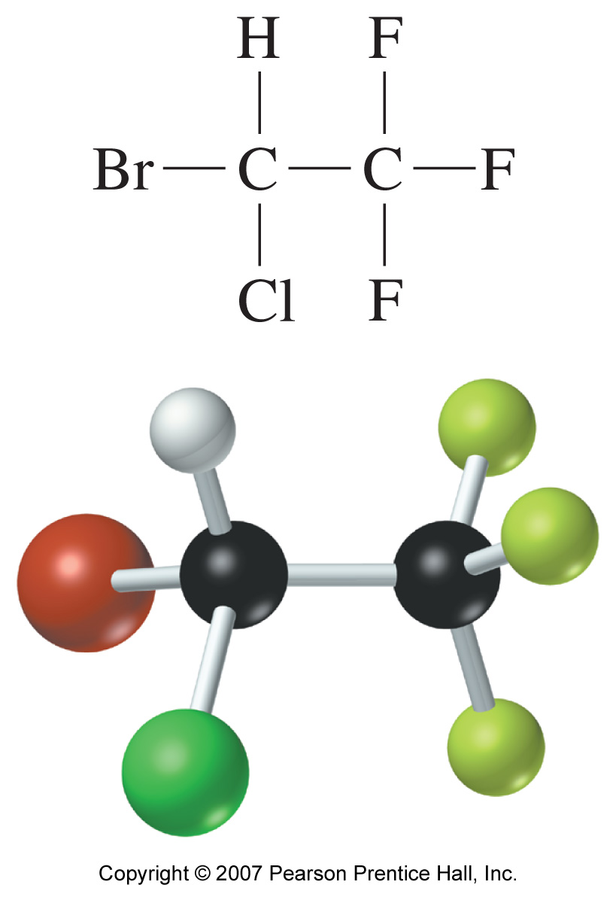
Composition of Chemical Compounds
Halothane C₂HBrClF₃
Molecular mass = 197.382 u
Molar mass = 197.382 g/mol
Molecular mass = [2 (mass C) + mass H + Mass Br + mass Cl + 3 (mass F)] u
Molar mass = Molecular mass in grams (g/mol)
Slide <number> of 32
General Chemistry: Chapter 3
Copyright © 2011 Pearson Canada Inc.
Notes:
Chemistry 140 Fall 2002
Molecular formula tells us there are TWO moles of C per mole of halothane.
We also know about the MASSES of the compound and its elemental components.
Therefore we can talk about PERCENT COMPOSITION BY MASS

Slide 18
Composition of Chemical Compounds
Halothane C₂HBrClF₃
Composition:
3 moles of F in 1 mole of halothane
2 moles of C in 1 mole of halothane
…
M(C₂HBrClF₃⁾ = 2M_{C} + M_{H} + M_{Br} + M_{Cl} + 3M_{F}
= (2 x 12.01) + 1.01 + 79.90 + 35.45 + (3 x 19.00)
= 197.38 g/mol
Slide <number> of 32
General Chemistry: Chapter 3
Copyright © 2011 Pearson Canada Inc.
Notes:
Chemistry 140 Fall 2002
Molecular formula tells us there are TWO moles of C per mole of halothane.
We also know about the MASSES of the compound and its elemental components.
Therefore we can talk about PERCENT COMPOSITION BY MASS

Slide 19
Example
How many moles of F atoms are there in 75.0 mL of halothane
(d = 1.871 g/mL)
1. How many grams of halothane in 75.0 ml?
2. How many moles of halothane in 75.0 ml?
3. How many moles of F atoms in 75.0 ml of halothane?

Slide 20
Example
How many milliliters of halothane would contain 1.00 x 10²⁴ Br atoms?
How many moles of Br atoms?
How many moles of halothane?
How many grams of halothane
How many milliliters?

Slide 21
% Compositions from the Chemical formula
The Chemical formula tells us the % composition of a compound.
H₂O Molar mass of H₂O =
18.01528 g of H₂O contain 2.01588 g of H and 15.9994 g of O
% of H =

Slide 22
% Compositions from the Chemical formula
The Chemical formula tells us the % composition of a compound.
H₂O Molar mass of H₂O = 18.01528 g
18.01528 g of H₂O contain 2.01588 g of H and 15.9994 g of O
% of O =
% H + % O =
Slide <number> of 32
General Chemistry: Chapter 3
Copyright © 2011 Pearson Canada Inc.

Slide 23
Conversely, one can find the formula of a compound from
experimentally determined % composition of compounds
Example:
2-deoxyribose has 44.77%C, 7.52% H and 47.71% O
1. Assume that you have 100.0 g of deoxyribose, then you have:
g of C
g of H
g of O
2. How many moles of each of the elements do you have?
Mole ratios
Notes:
Chemistry 140 Fall 2002
If you know the molecular wt it is beneficial to choose that number, then only first three steps are required.

Slide 24
Conversely, one can establish Formulas from
Experimentally Determined % Composition of Compounds
Example:
2-deoxyribose has 44.77%C, 7.52% H and 47.71% O
3. Write a tentative formula.
4. Convert the subscripts into small whole numbers.
5. If not yet “whole” numbers, multiply ALL by small number to convert them into whole numbers.
Slide <number> of 32
General Chemistry: Chapter 3
Copyright © 2011 Pearson Canada Inc.
Notes:
Chemistry 140 Fall 2002
If you know the molecular wt it is beneficial to choose that number, then only first three steps are required.

Slide 25
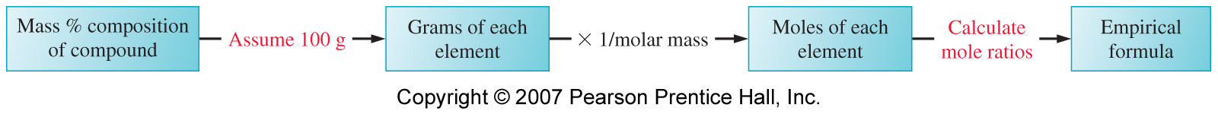
Conversely, one can establish Formulas from
Experimentally Determined % Composition of Compounds
5 Step approach:
Choose an arbitrary sample size (100g).
Convert masses to amounts in moles.
Write a formula.
Convert formula to small whole numbers.
Multiply all subscripts by a small whole number to make the subscripts integral.
Slide <number> of 32
General Chemistry: Chapter 3
Copyright © 2011 Pearson Canada Inc.
Notes:
Chemistry 140 Fall 2002
If you know the molecular wt it is beneficial to choose that number, then only first three steps are required.

